Slide 1





Classification of elements and periodicity in properties
Chapter 3

Slide 2



Lets recall and revise…
Law of triads:-
According to law of triads elements were placed in a group of 3 and they were called triads. These were placed in the increasing order of atomic masses
Newland’s law of octaves:-
the elements were placed in increasing order of their atomic weights and it was noted that every eighth element had properties similar to the first element .
The relationship was just like every eighth note that resembles the first in
octaves of music. Newlands’s Law of Octaves seemed to be true to elements
only upto calcium.

Slide 3
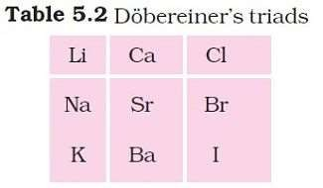
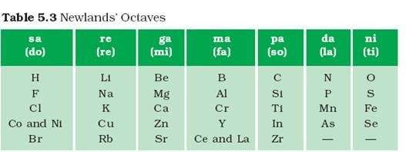

Slide 4







Mendeleev’s periodic law
“The properties of the elements are a periodic function of their atomic weights.”
Mendeleev arranged elements in horizontal rows and vertical columns of a table in order of their increasing atomic weights in such a way that the elements with similar properties occupied the same vertical column or group .

Slide 5


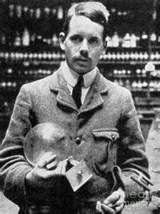







Mendeleev left gaps under silicon and aluminium and those were known as eka aluminium and eka silicon.
Later it was discovered that eka aluminium had properties similar to gallium and eka silicon had properties similar to germanium.
According to modern periodic law,
“The physical and chemical properties of the elements are periodic functions of their atomic numbers”.
Modern form of periodic table was discovered by henry Mosley and hence it was also called henry Mosley's periodic table.

Slide 6
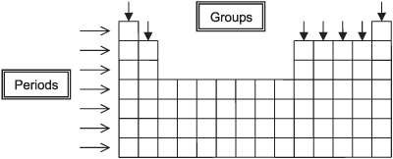
The Periodic Law revealed important analogies among the 94 naturally occurring elements (neptunium and plutonium like actinium and protoactinium are also found in pitch blende – an ore of uranium).
The horizontal rows of the periodic table are called periods
while the vertical columns are called groups or families.

Slide 7






DIVISION OF PERIODIC TABLE
The periodic table is divided into 4 blocks mainly the s-block p-block d- block and f-block.
S-block:-
The elements of Group 1 (alkali metals) and Group 2 (alkaline earth metals) which have ns¹ and ns² outermost electronic configuration belong to the s- Block Elements.
They are all reactive metals with low ionization enthalpies. They lose the outermost electron(s) readily to form 1+ ion in the case of alkali metals or 2+ ion in the case of alkaline earth metals.
The metallic character and the reactivity increase as we go down the group. Because of high reactivity they are never found pure in nature.
The compounds of the s-block elements, with the exception of those of
lithium and beryllium are predominantly ionic.

Slide 8
P-block:
The p-Block Elements comprise those belonging to Group 13 to 18 and these together with the s-Block Elements are called the Representative Elements or Main Group Elements.
The outermost electronic configuration varies from ns²np¹ to ns²np⁶ in each period. At the end of each period is a noble gas element with a closed valence shell ns²np⁶ configuration.
All the orbitals in the valence shell of the noble gases are completely filled by electrons and it is very difficult to alter this stable arrangement by the addition or removal of electrons.
The noble gases thus exhibit very low chemical reactivity. Preceding the noble gas family are two chemically important groups of non-metals. They are the halogens (Group 17) and the chalcogens (Group 16).
These two groups of elements have highly negative electron gain enthalpies and readily add one or two electrons respectively to attain the stable noble gas configuration.
The non-metallic character increases as we move from left to right across a period and metallic character increases as we go down the group

Slide 9





D-block:
Elements in which the d-orbitals are completely filled are called the d-block elements.
General electronic configuration is (n-1)d¹⁻¹⁰ns¹⁻² . Properties:-
-Shows catalytic properties
-forms coloured ions
-shows paramagnetic properties
-forms complexes
They are often referred to as transition metals as they are placed between metals and non metals and also due to their charecteristic feature.

Slide 10













F-block:
Elements in which the f-orbital is completely filled are called the f- block elements.
General electronic configuration is ns²(n-1)d⁰⁻¹(n-2)f¹⁻¹⁰. Inner transition metals are known as f-block elements.
They have incomplete d-orbital electronic confg in their normal state and in their oxidation state.
They are generally radioactive.

Slide 11



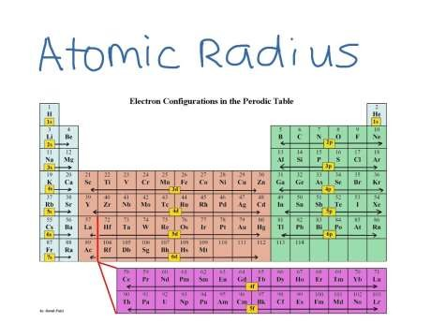






Trends in physical properties
We will be studying,
Atomic radius Ionic radius
Ionisation enthalpy Electron gain enthalpy
Electronegativity Oxidation states
Chemical reactivity

Slide 12

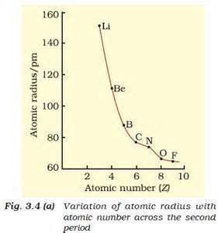
Atomic radius
The atomic size generally decreases across a period as for the elements of the second period. It is because within the period the outer electrons are in the same valence shell and the effective nuclear increases as the atomic number increases.
This results in increased attraction between nucleus and the electron
Atomic radius decreases from left to right as principal quantum number increases.
It also increases down a group as
the number of shells increase.

Slide 13


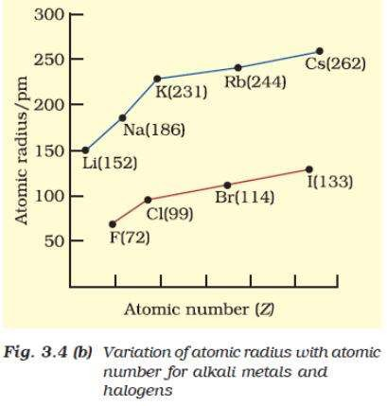
Variation of atomic size to that of alkali metals

Slide 14




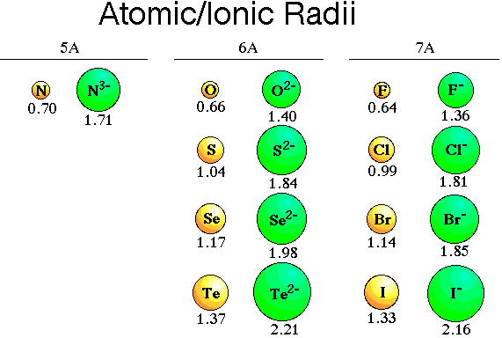



Ionic radius
The removal of an electron from an atom results in the formation of a cation, whereas gain of an electron leads to an anion.
A cation is always smaller than its parent atom while a anion is always greater to its parent atom.
This is due to electron electron repulsion.
Isoelectronic species are those species which have Two or more species with same number of atoms, same number of valence electrons and same structure, regardless of the nature of elements involved.
The cation with the greater positive charge will have a smaller radius because of the greater attraction of the electrons to the nucleus. Anion with the greater negative charge will have the larger radius. In this case, the net repulsion of the electrons will outweigh the nuclear charge and the ion will expand in size.

Slide 15

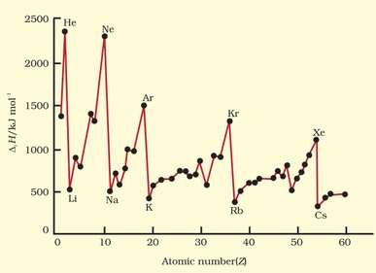
Ionisation enthalpy
A quantitative measure of the tendency of an element to lose electron is given by its Ionization Enthalpy. It represents the energy required to remove an electron from an isolated gaseous atom (X) in its ground state. In other words, the first ionization enthalpy for an element X is the enthalpy change (∆_{i} H) for the reaction X(g) → X⁺(g) + e–
The ionization enthalpy is expressed in units of kJ mol–1. We can define the second ionization enthalpy as the energy required to remove the second most loosely bound electron
X⁺(g) → X²⁺ (g) + e–
Energy is always required to remove electrons from an atom and hence ionization enthalpies are always positive.
The second ionization enthalpy will be higher than the first ionization enthalpy because it is more difficult to remove an electron from a positively charged ion than from a neutral atom. In the same way the third ionization enthalpy will be higher than the second and so on. The
term “ionization enthalpy”, if not qualified, is taken as the first ionization enthalpy.

Slide 16
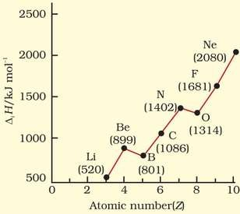
Energy is always required to remove electrons from an atom and hence ionization enthalpies are always positive.
The second ionization enthalpy will be higher than the first ionization enthalpy because it is more difficult to remove an electron from a positively charged ion than from a neutral atom.
In the same way the third ionization enthalpy will be higher than the second and so on. The term
“ionization enthalpy”, if not qualified, is taken as the first ionization enthalpy.
We will find maxima at the noble gases which have closed electron shells and very stable electron configurations. On the other hand, minima occur at the alkali metals and their low ionization enthalpies can be correlated with their high reactivity.

Slide 17













Shielding effect
In multi electron atoms , the electrons are present in the outer most shell and they do not experience a full positive charge hence they are shielded or screened away from the nucleus.
For Eg:- in the same subshell the p-electrons will get shielded away by the s-electron as p-electron is away from the influence of nucleus and hence it s does not experience a complete positive charge !

Slide 18



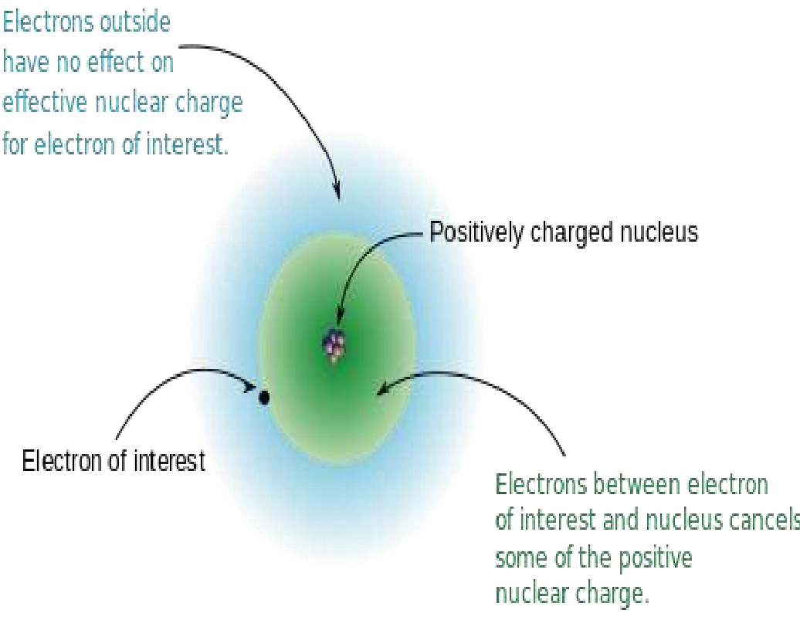
Ionisation and atomic radius are correlated in 2 ways :-
(i) the attraction of electrons towards the nucleus, and (ii) the repulsion of electrons from each other. The effective nuclear charge experienced by a valence electron in an atom will be less than the actual charge on the nucleus because of “shielding” or “screening” of the valence electron from the nucleus by the intervening core electrons.

Slide 19

Anomalies
2s electron of lithium is shielded away.
The 2s electron in lithium is shielded from the nucleus by the inner core of 1s electrons. As a result, the valence electron experiences a net positive charge which is less than the actual charge of +3. In general, shielding is effective when the orbitals in the inner shells are completely filled. This situation occurs in the case of alkali metals which have single outermost ns-electron preceded by a noble gas electronic configuration.

Slide 20
When we move from lithium to fluorine across the second period, successive electrons are added to orbitals in the same principal quantum level and the shielding of the nuclear charge by the inner core of electrons does not increase very much to compensate for the increased attraction of the electron to the nucleus.
Thus, across a period, increasing nuclear charge outweighs the shielding. Consequently, the outermost electrons are held more and more tightly and the ionization enthalpy increases across a period.
As we go down a group, the outermost electron being increasingly farther from the nucleus, there is an increased shielding of the nuclear charge by the electrons in the inner levels.
In this case, increase in shielding outweighs the increasing nuclear charge and the removal of the outermost electron requires less energy down a group.

Slide 21

It is easier to remove 2p electron of boron than 2s electron of beryllium.
The first ionisation enthalpy of boron is slightly less than beryllium though the former has a greater nuclear charge. When we consider the same principal quantum level, an s-electron is attracted to the nucleus more than a p-electron.
In beryllium, the electron removed during the ionization is an s- electron whereas the electron removed during ionization of boron is a p-electron.
The penetration of a 2s-electron to the nucleus is more than that of a 2p-electron; hence the 2p electron of boron is more shielded from the nucleus by the inner core of electrons than the 2s electrons of beryllium.
Therefore, it is easier to remove the 2p-electron from boron compared to the removal of a 2s- electron from beryllium. Thus, boron has a smaller first ionization enthalpy than beryllium

Slide 22
First ionisation enthalpy of oxygen is less than nitrogen.
The smaller first ionization enthalpy of oxygen compared to nitrogen. This arises because in the nitrogen atom, three 2p- electrons reside in different atomic orbitals (Hund’s rule) whereas in the oxygen atom, two of the four 2p- electrons must occupy the same 2p-orbital resulting in an increased electron-electron repulsion. Consequently, it is easier to remove the fourth 2p- electron from oxygen than it is, to remove one of the three 2 p- electrons from nitrogen.

Slide 23










Give reasons
Why are lanthanides and actinides placed separately at the bottom of the periodic table ?
For convenience and systematic study of elements having similar properties.
To maintain the structure of periodic table of classification by keeping elements with similar properties in a similar way.
Elements like Zn , Pd, Cd are not considered transition elements ?
(a) As they have incompletely filled d-orbitals
Chemistry of Actinoids is complicated why ?
As they show large no of oxidation states

Slide 24

Electron gain enthalpy
when an electron is added to a neutral gaseous atom (X) to convert it into a negative ion, the enthalpy change accompanying the process is defined as the Electron Gain Enthalpy (∆_{eg}H).
Electron gain enthalpy provides a measure of the ease with which an atom adds an
electron to form anion
X(g)+e– → X–(g)
Depending on the element, the process of adding an electron to the atom can be either endothermic or exothermic
Added to the atom and the electron gain enthalpy is negative. For example, group 17 elements (the halogens) have very high negative electron gain enthalpies because they can attain stable noble gas electronic configurations by picking up an electron
On the other hand, noble gases have large positive electron gain enthalpies because the electron has to enter the next higher principal quantum level leading to a very unstable electronic configuration. It may be noted that electron gain enthalpies have large negative values toward the upper right of the periodic table preceding the noble gases.

Slide 25
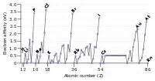
As a general rule, electron gain enthalpy becomes more negative with increase in the atomic number across a period. The effective nuclear charge increases from left to right across a period and consequently it will be easier to add an electron to a smaller atom since the added electron on an average would be closer to the positively charged nucleus. We should also expect electron gain enthalpy to become less negative as we go down a group because the size of the atom increases and the added electron would be farther from the nucleus

Slide 26

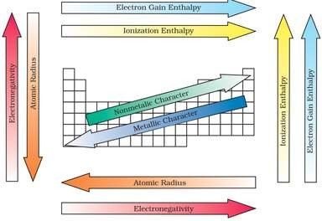







electronegativity
A qualitative measure of the ability of an atom in a chemical compound to attract shared electrons to itself is called electronegativity.
Flourine has the highest electronegativity value of 4.
It is the most electronegative element.

Slide 27
Non-metallic elements have strong tendency to gain electrons. Therefore, electronegativity is directly related to that non-metallic properties of elements.
It can be further extended to say that the electronegativity is inversely related to the metallic properties of elements. Thus, the increase in electronegativities across a period is accompanied by an increase in non-metallic properties (or decrease in metallic properties) of elements.
Similarly, the decrease in electronegativity down a group is accompanied by a decrease in non-metallic properties (or increase in metallic properties) of elements.

Slide 28





Oxidation state
The valence equals to the number of electrons present in the outermost shell.
The term oxidation state interchangeably means valence.
Fluorine has the oxidation state of -1 but in compounds like OF₂ it exhibits +2 oxidation state.
Oxidation state determines the oxidation number of the element.

Slide 29












Chemical reactivity
Diagonal relationship refers to the relationship between certain pairs of diagonally adjacent elements in the second and in the 3rd period respectively.
This characteristic property is shown by s- and p-blocks respectively.

Slide 30
he anomalous behaviour is attributed to their small size, large charge/ radius ratio and high electronegativity of the elements. In addition, the first member of group has only four valence orbitals (2s and 2p) available for bonding, whereas the second member of the groups have nine valence orbitals (3s, 3p, 3d).
As a consequence of this, the maximum covalency of the first member of each group is 4 (e.g., boron can only form [BF4 ]⁻ , whereas the other members of the groups can expand their valence shell to accommodate more than four pairs of electrons e.g., aluminium forms [AlF₆ ]³⁻ .
Furthermore, the first member of p-block elements displays greater ability to form pπ – pπ multiple bonds to itself (e.g. C=C,C≡C, N=N, N ≡ Ν) and to other second period elements (e.g., C
= O, C = N, C ≡ N, N = O) compared to subsequent members of the same group.

Slide 31











Metallic character decreases from right to left whereas non metallic character increases from left to right.
This is due to addition of electrons in various orbitals.
Elements which combine on the two extremes of the periodic table form oxides like peroxides and super oxides.
Some are acidic basic and neutral or bette rknown as amphoteric oxides
Metals from basic oxides , non metal form acidic oxides.
Among transition metals (3d series), the change in atomic radii is much smaller as compared to those of representative elements across the period. The change in atomic radii is still smaller among inner-transition metals (4f series). The ionization enthalpies are intermediate between those of s- and p-blocks. As a consequence, they are less electropositive than group 1 and 2 metals.

Slide 32

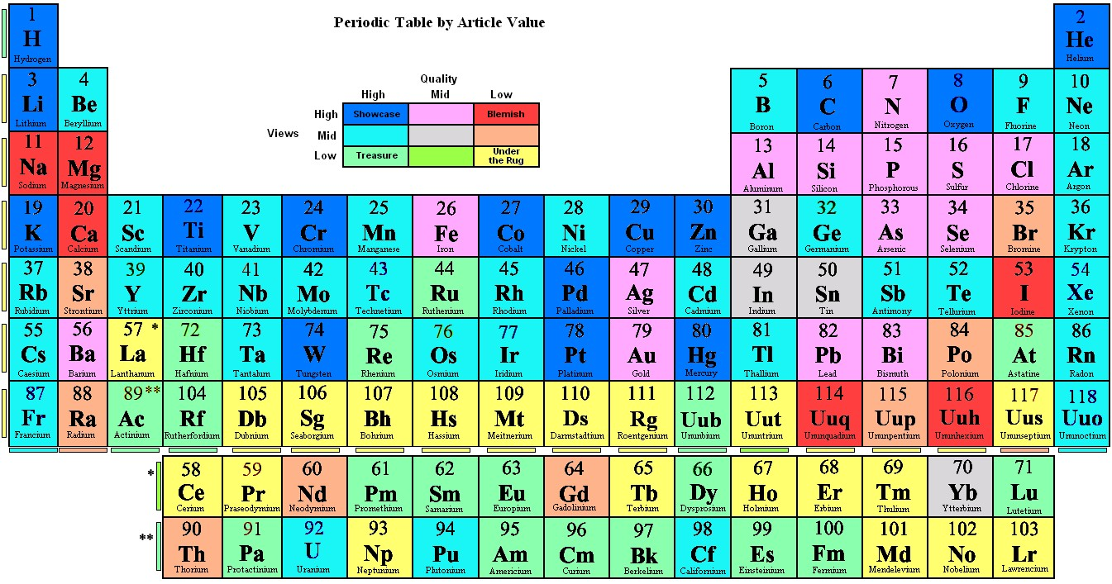
The end.

